Slide 1
Social Media API Project
Facebook Graph API

Slide 2
Goal
To learn how to use APIs
To track social media numbers through Python
To analyse performance of social media accounts
Excel Export
Python visualisations e.g. Matplotlib

Slide 3
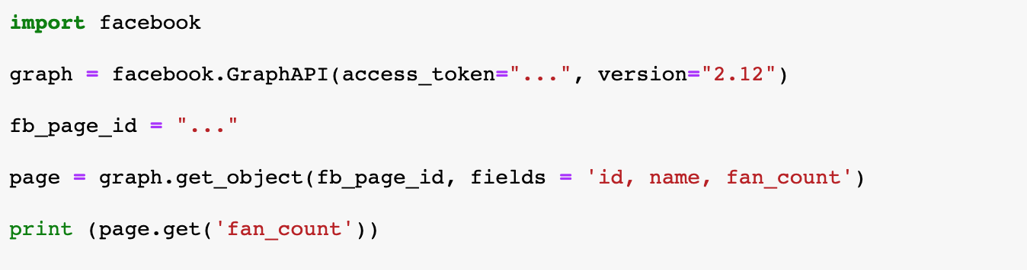
Process
Using the Facebook SDK for Python:
Authenticate with the Graph API for Access
Recognise a Facebook Page ID
Getting the Graph Object
Printing a fan count

Slide 4
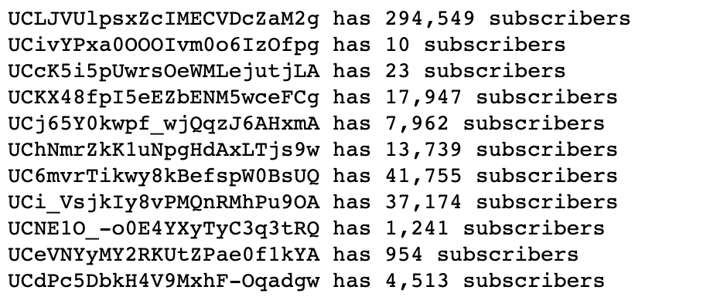
Process
Using the Facebook SDK for Python:
Output to have a number associated with the page
And a number showing the follower count on the page

Slide 5
Current Limitations
The need for public content page access to get public data
Then the authentication process will work
Application currently does not fully work due to no content access

